Slide 1
In Vivo Simulation of the Excretory System In Vitro
Michael Muller : DATA 604

Slide 2
Sources: Journals : Reputable Sources
Gastrointestinal process times : http://www.gastrojournal.org/article/0016-5085(87)90837-7/pdf
Separation of Food / Water & the disqualification of child data : http://adc.bmj.com/content/archdischild/59/7/649.full.pdf
Validation Quotas for Intestines / Stomach & disqualification of data outside USA : https://www.ncbi.nlm.nih.gov/pmc/articles/PMC3271260
Similar model : http://ieeexplore.ieee.org/document/271225/
Corroborating data on intestine / stomach quotas : http://onlinelibrary.wiley.com/doi/10.1111/j.1365-2036.2007.03564.x/abstract
Water Quotas : https://www.cdc.gov/nchs/products/databriefs/db242.htm
Bladder Quotas : https://www.mayoclinic.org/healthy-lifestyle/nutrition-and-healthy-eating/in-depth/water/art-20044256
http://www.cdhd.ne.gov/information/healthy-living-a-education/122-nutrition
Time Awake : https://sleepfoundation.org/sites/default/files/2002SleepInAmericaPoll.pdf
GI Tract : https://www.niddk.nih.gov/health-information/digestive-diseases/digestive-system-how-it-works
Historical Scatological Data : https://www.reddit.com/r/dataisbeautiful/comments/2sy4t0/a_year_of_poop_an_analysis_of_every_poop_made_by/

Slide 3
Project Goal & Limitations
The Goal : Create a simulation framework for predicting excrementory stress.
i.e.(with X schedule and Y consumables at Z intervals; what scatological buildup can I expect?)
The limitations :
(1) Limited relevant datasets on the human body.
(2) Variation in the human body; every human requires a model tailored specifically to themselves.
(3) Research indicates that diet is a significant coefficient to total time consumables (entities) spend in system.
(4) Many organs perform different functions for different entity types (Remedy with data tables or alternate pathing)

Slide 4
What we want to see : A compartmentalized model
Food entities should be processed anywhere between 10-59. Anything above 59 represents Food back up.
Stomach should process between 2-5 Hours
Small Intestine should process between 2-6 Hours
Large Intestine should process between 4-11 Hours
Water entities should be processed on average, 2 hours.

Slide 5
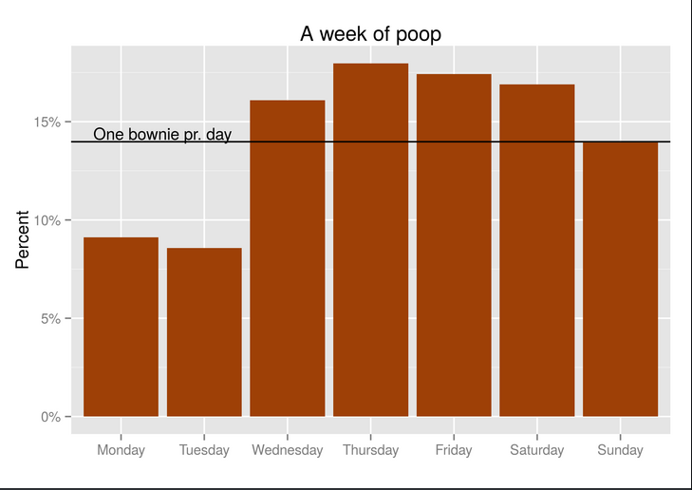
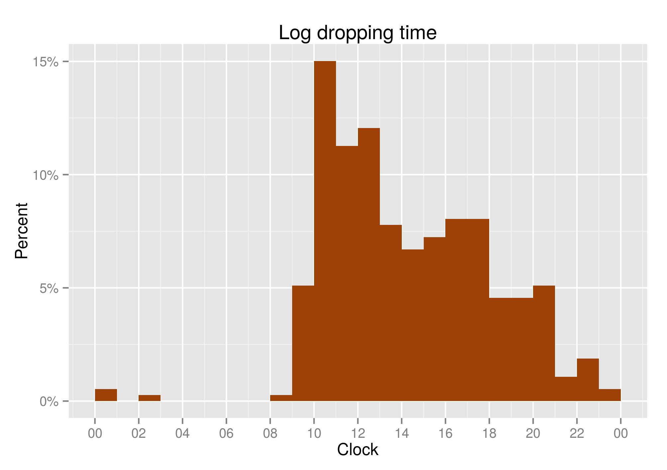
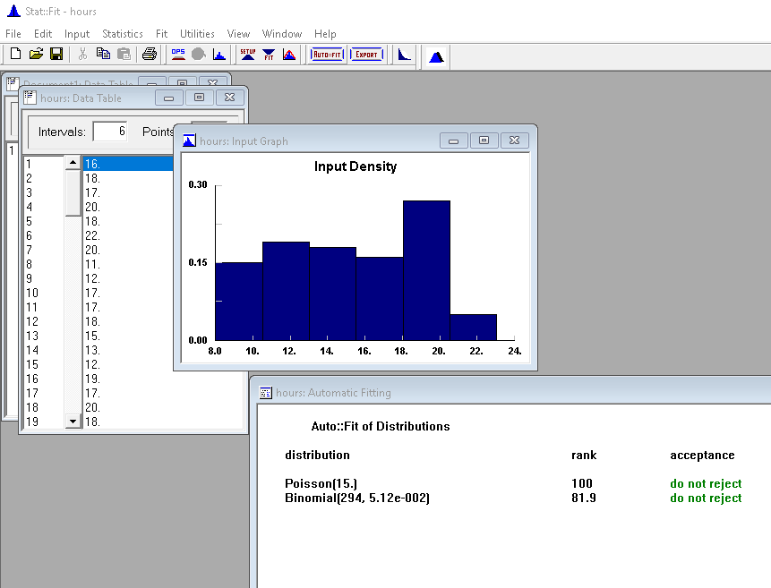
The Human Schedule : Validity
To reduce data variability : the simulation is modeled after an ‘average’ healthy male age 18-30.
Research was gathered on sleeping habits : AVG 6.9/7.5 Hours weekday/end
Water quotas : AVG 5.5 drinks per day : AVG 3 urinations per day : W = 1.5+ (Data inconclusive)
Food quotas : AVG 3 meals per day : AVG 1 excrement per day : Exp Dist from 9am-10pm : W = 15-59

Slide 6
Scope of excrementory model
Both the entities, Water and Food travel a simplified GI Tract splitting at the esophagus.
Food travels by sequence*
[Mouth,Esophagus,Stomach,Small Intestine,Large Intestine,Rectum,Anus]
Water travels by sequence*
[Mouth,Esophagus,RenalSystem,Bladder,Urethra]
*Research Paper justifies the exclusion of stomach/Intestine for Water sequence.

Slide 7
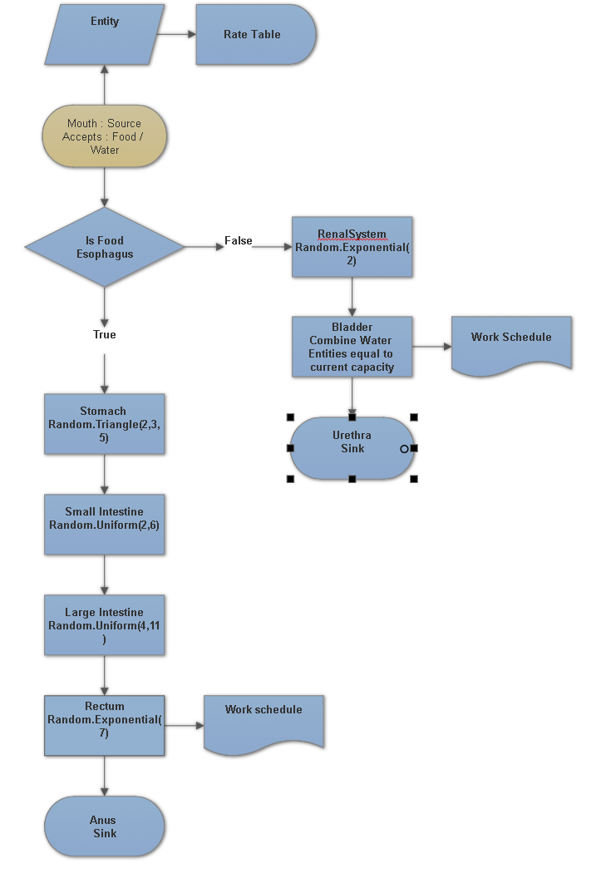

Slide 8
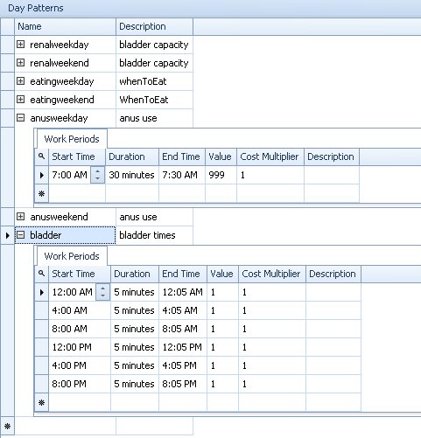
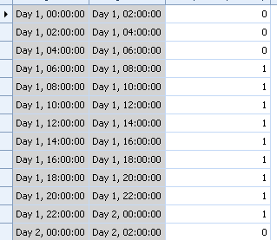
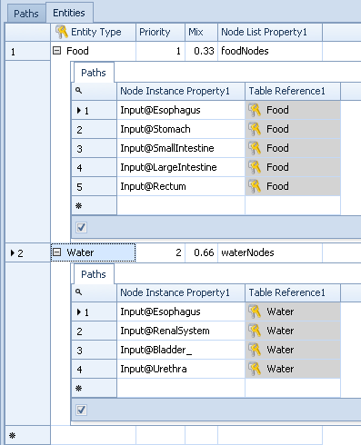
Modeling techniques used
Link weights
Rate tables : Custom arrival intervals
Work schedules
Node lists
Dynamic buffer capacities
Stat::Fit
Batching

Slide 9
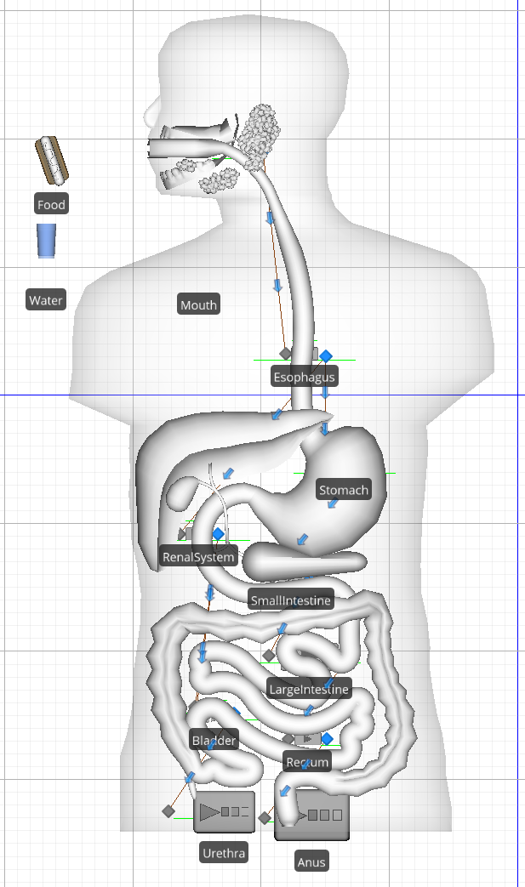
The Status Quo Model
Food and Water travel from Mouth:Source
Split at Esophagus:Server
Water accumulates at the Bladder:Combiner
Food accumulates in a queue at the Rectum:Server
Food and Water sink into the Urethra and Anus

Slide 10
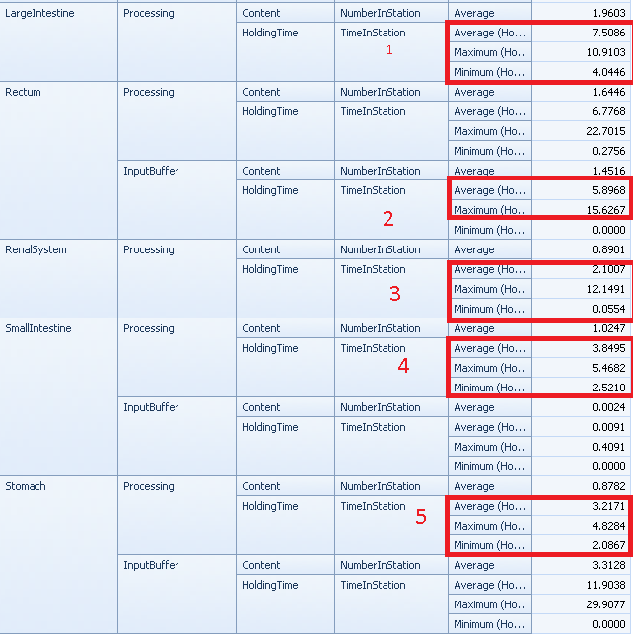
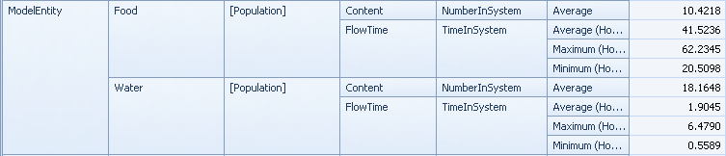
Status Quo Results
L.I. : 4-11 Hours Verified
Rectum : AVG tells us 1-2 excrements a day
Renal : AVG processing time 2 Hours Verified
S.I. : 2.5-5.4 Hours...Verified
Stomach : 2-5 Hours...Verified
Food processes between 20-62 Hours
Water processes between 2-6 Hours

Slide 11
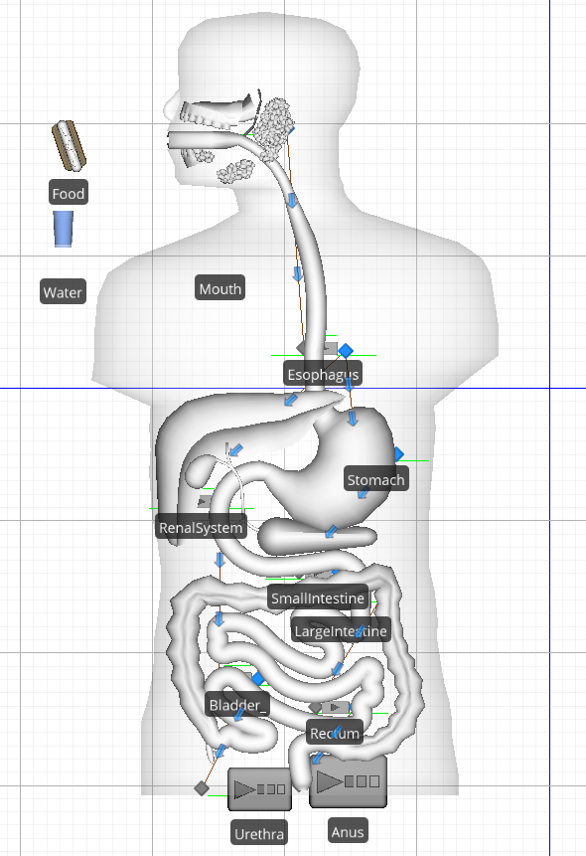
Interventional Model
Previously bladder would empty itself whenever 2 cups of water entered.
Change to Water tract : Bladder now releases itself 3 times daily; while awake.
Why? It is normal for someone to drink 6 cups of Water each day; and urinate 3 times.
I want to see how much urine builds up, when demonstrating bodily restraint.
Previously rectum would empty twice according to stat::fit distribution recommendation :
according to Historical data.
Change to Food tract : Rectum now only empties itself once a day. In the morning
Why? It is normal for someone to empty their rectum once a day. I want to demonstrate the
Versatility of this model by changing the schedule.

Slide 12
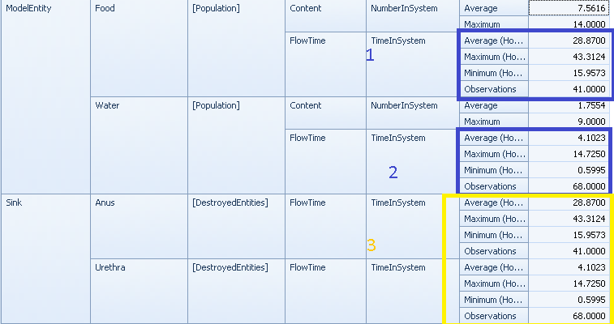
Interpretation of results :
Healthy digestion
Amount of water held doubles
Food tract seems healthier

